Slide 1
Forex Strategy Secrets
What We're
Going to
Cover

Slide 2
Forex Strategy Secrets
Jump Start
Launch Pad
Alerts

Slide 3
Forex Strategy Secrets
If you like what
You see

Slide 4
Forex Strategy Secrets
We will show you
How to get a
One week
FREE
Test drive

Slide 5
Forex Strategy Secrets
Jump Start
Strategy

Slide 6
What is
“Jump Start”

Slide 7
Forex Strategy Secrets
“Jump Start” is:
A Forex Entry
Strategy

Slide 8
Forex Strategy Secrets
What you will learn:
Exact Entry signals

Slide 9
Forex Strategy Secrets
What you will learn:
Exact Entry signals
How to use indicators to find entry points
in the forex market.

Slide 10
Forex Strategy Secrets
What you will learn:
Exact Entry signals
How to use indicators to find entry points
in the forex market.
You will learn how to trade in the present

Slide 11
Forex Strategy Secrets
Lets look
At a
Chart to see how
It works

Slide 12
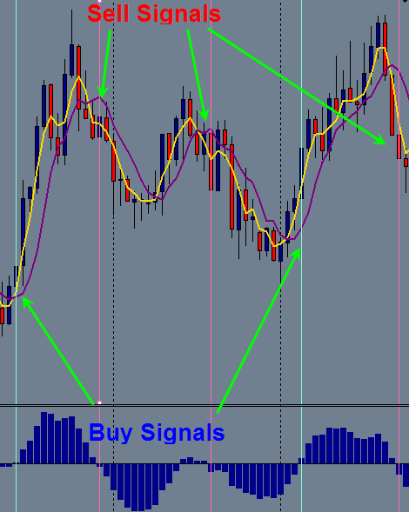
Forex Strategy Secrets

Slide 13
Forex Strategy Secrets
Launch Pad

Slide 14
Forex Strategy Secrets
“Launch Pad” is:
Our Foundational
Forex Trading System

Slide 15
Forex Strategy Secrets
What you will learn:
Exact Entry signals
Exact Exit signals

Slide 16
Forex Strategy Secrets
What you will learn:
Exact Entry signals
Exact Exit signals
You trade in the present

Slide 17
Forex Strategy Secrets
What you will learn:
Exact Entry signals
Exact Exit signals
You trade in the present
Money and Risk Management

Slide 18
Forex Strategy Secrets
What you will learn:
Exact Entry signals
Exact Exit signals
You trade in the present
Money and Risk Management
How to identify a trend

Slide 19
Forex Strategy Secrets
What you will learn:
Exact Entry signals
Exact Exit signals
You trade in the present
Money and Risk Management
How to identify a trend
How to use multiple signals

Slide 20
Forex Strategy Secrets
What you will learn:
Exact Entry signals
Exact Exit signals
You trade in the present
Money and Risk Management
How to identify a trend
How to use multiple signals
How to keep a trade journal
How to write a trading plan

Slide 21
Forex Strategy Secrets
What you will learn:
Exact Entry signals
Exact Exit signals
You trade in the present
Money and Risk Management
How to identify a trend
How to use multiple signals
How to keep a trade journal
How to write a trading plan
AND much MORE…

Slide 22
Forex Strategy Secrets
“LP” is for the:
New Traders
Experienced Traders
That are not making
The money they would like

Slide 23
Forex Strategy Secrets
The Launch Pad
Trading System
is yours for life
for a one time fee
of $97.00

Slide 24
Forex Strategy Secrets
What do you
Get with
Launch Pad
Membership

Slide 25
Forex Strategy Secrets
The
Launch Pad
Membership Is
Level 1 of the
Forex Profit Classroom

Slide 26
Forex Strategy Secrets
Here is what you get with
YOUR
membership subscription:

Slide 27
Forex Strategy Secrets
Launch pad training videos
Norwood Alerts

Slide 28
Forex Strategy Secrets
Launch pad training videos
Norwood Alerts
Trend alerts

Slide 29
Forex Strategy Secrets
Two Coaching Webinars
Per Month
Instruction…Assignments

Slide 30
Forex Strategy Secrets
Two Coaching Webinars
Per Month
Instruction…Assignments
Q & A

Slide 31
Forex Strategy Secrets
Two Coaching Webinars
Per Month
Instruction…Assignments
Q & A
Hot Seat Have trades reviewed

Slide 32
Forex Strategy Secrets
Video and Audio
ARCHIVES
Webinars
Q & A
Training Sessions

Slide 33
Forex Strategy Secrets
You will also Gain
Access to
The
Accelerated Program

Slide 34
Forex Strategy Secrets
By Using The
Acceleration Program
Along with the Bonus Material
Learn to trade Profitably
In … 2-4 months
Not … 2 to 4 years

Slide 35
Forex Strategy Secrets
When you invest in the
Launch Pad training course
You will receive access to the
Forex Profit Classroom
For 30 days.

Slide 36
Forex Strategy Secrets
If you choose to discontinue
after the 30 day trial period do so
by sending us an email.
We will promptly cancel
the membership .
But you get to keep Launch Pad for life.

Slide 37
Forex Strategy Secrets
If you like what you see
We can show you how
You will receive a discounted
Monthly rate for your membership
Simply for investing in Launch
Pad today.

Slide 38
Forex Strategy Secrets
We will show you how to:
Not Lose Money

Slide 39
Forex Strategy Secrets
We will show you how to:
Not Lose Money
How to start making Money

Slide 40
Forex Strategy Secrets
We will show you how to:
Not Lose Money
How to start making Money
Why and How you are
making money

Slide 41
Forex Strategy Secrets
We will show you how to:
Not Lose Money
How to start making Money
Why and How you are
making money
4. How to reach your
Financial Dreams

Slide 42
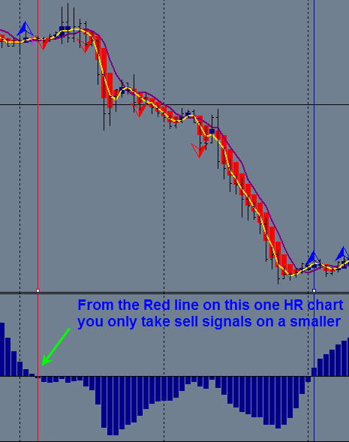
Forex Strategy Secrets

Slide 43
Forex Strategy Secrets
What are
Alerts?

Slide 44
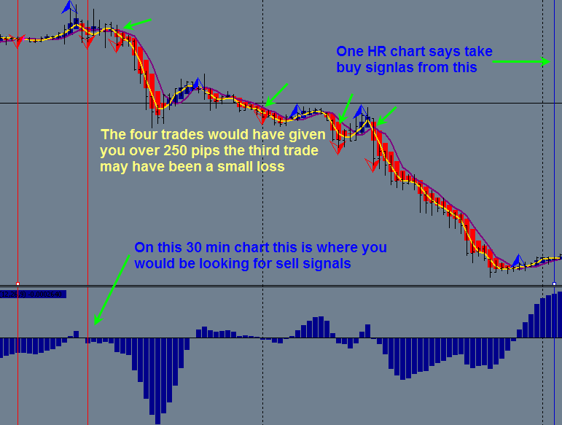
Forex Strategy Secrets

Slide 45
What does
“Launch Pad”
Cost

Slide 46
Forex Strategy Secrets
Investment
Of
$97
(One time fee)

Slide 47
Forex Strategy Secrets
Here is a Review of the
Bonuses
You get
With your purchase of
“Launch Pad
membership”

Slide 48
Forex Strategy Secrets
This is what you Get
Launch pad training video course
Norwood Alerts
Trend Alerts
US Trading Room (3 / wk) = 6 hours
Two Coaching Webinars Per Month
All Archived videos for LP

Slide 49
Forex Strategy Secrets
This comes with
Our
30 day
GUARANTEE

Slide 50
Forex Strategy Secrets
There are two
Links
A
Jump Start Link
And A
Launch Pad Link

Slide 51
Forex Strategy Secrets
With the
Launch Pad Link
You also get
Jump Start

