Slide 1
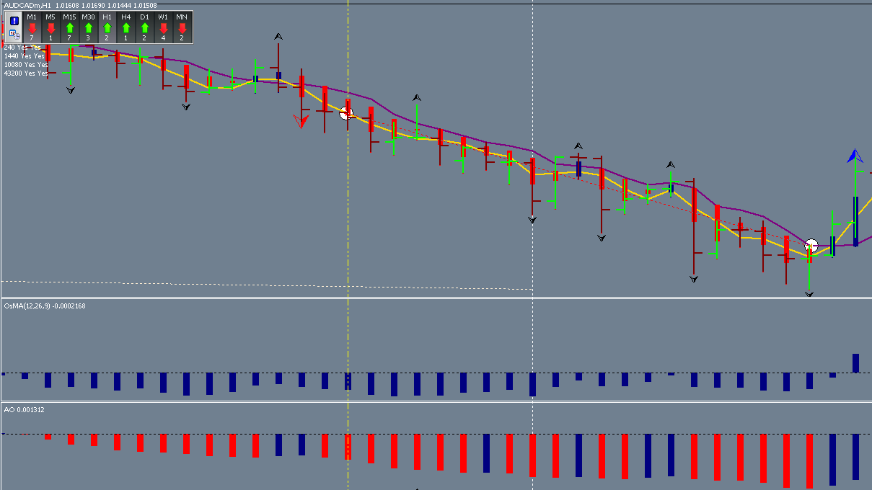
100 pips

Slide 2
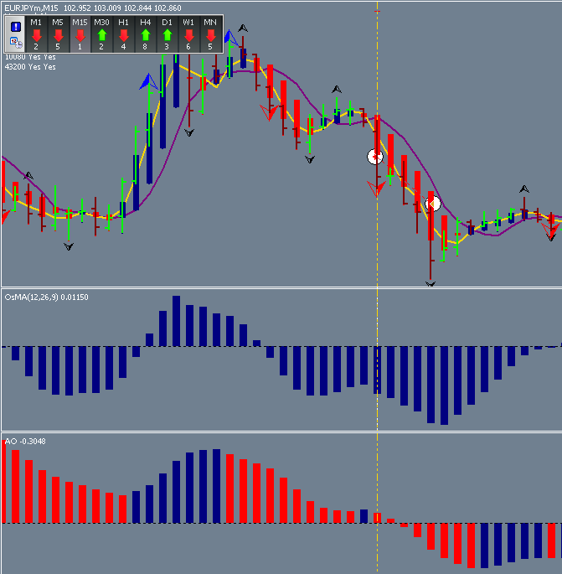
20 pips

Slide 3
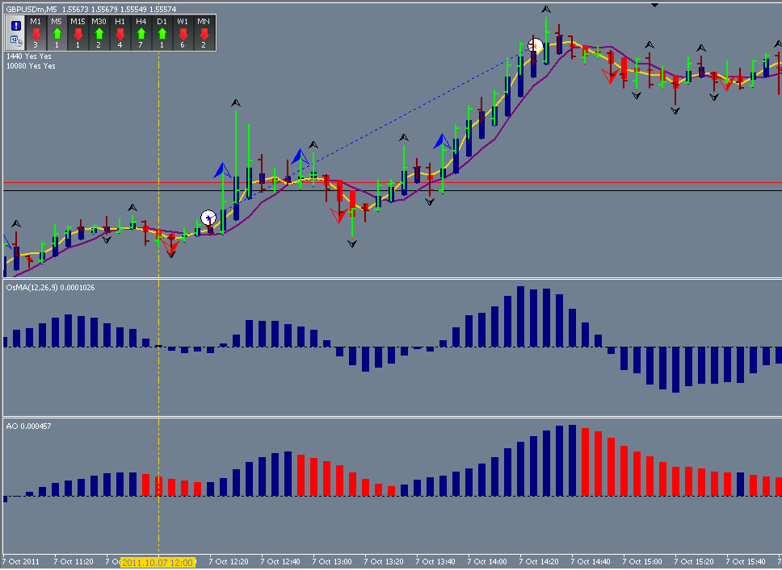
86 pips

Slide 4
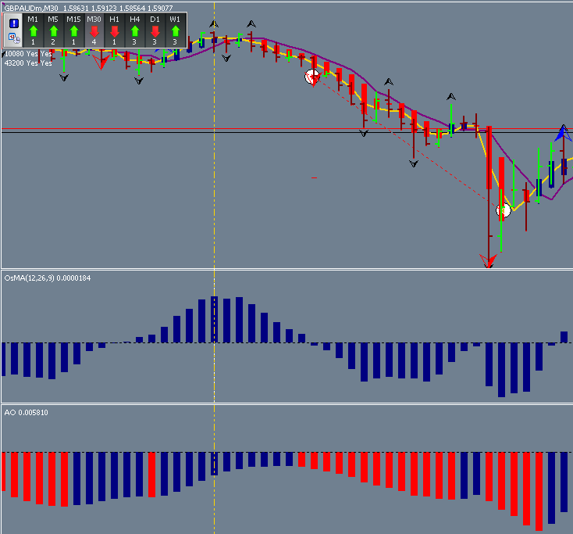
194 pips

Slide 5
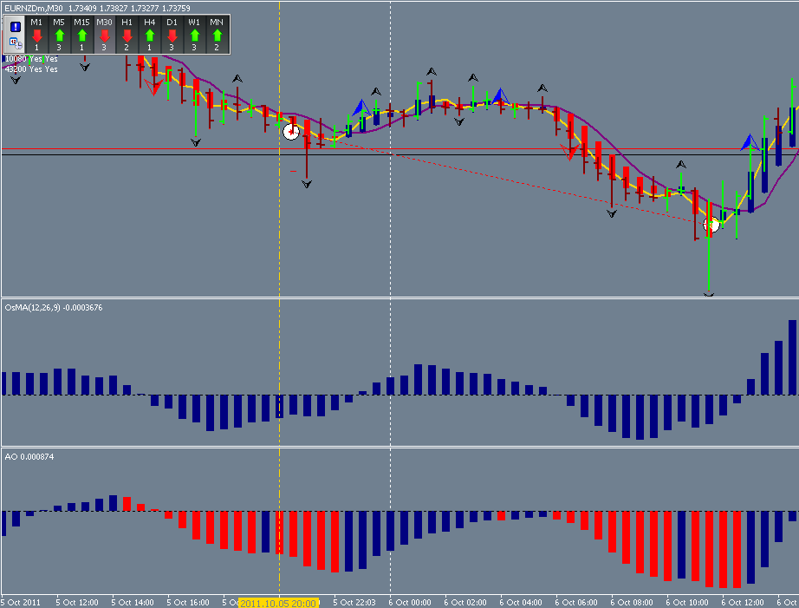
320 pips

Slide 6
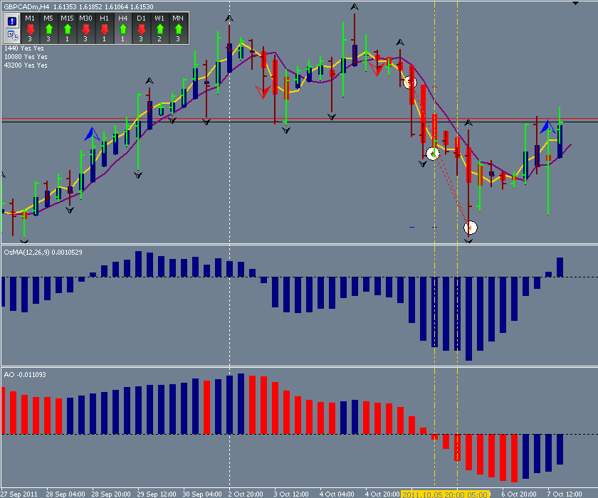
320 pips
160 pips
Add-on

Slide 7
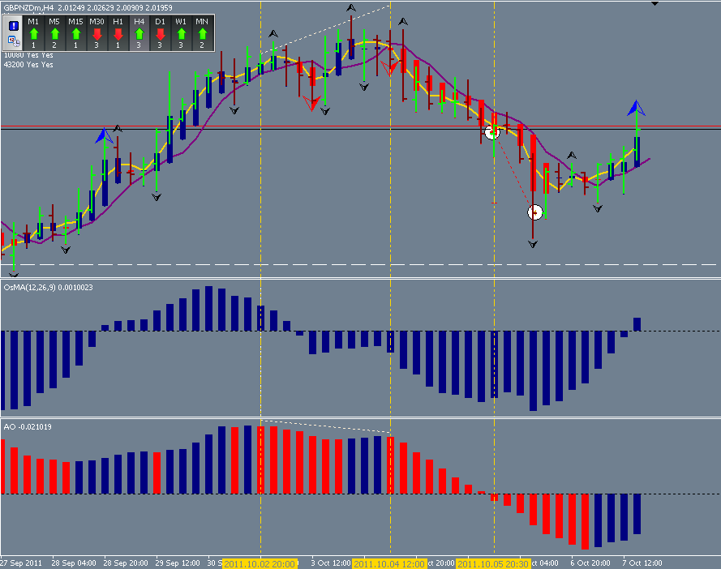
276 pips

Slide 8
Weekly Overview
AUDCAD 100 pips
EURJPY 20 pips
EURUSD 4 pips
GBPJPY -25 pips
EURAUD -16 pips
GPBCAD 320 pips
GBPCAD 160 pips
GBPNZD 276 pips
EURNZD 124 pips
GBPAUD 194 pips
GBPUSD 86 pips
Total trades 11
Wins 9
Loss 2
Total pips 1315
Total - pips -41
Net + pips +1274 pips

